Slide 1
Dive into WPF Playing tricks with the Visual Tree
Pavan Podila
Strategic Research, Liquidnet Holdings
http://blog.pixelingene.com

Slide 2
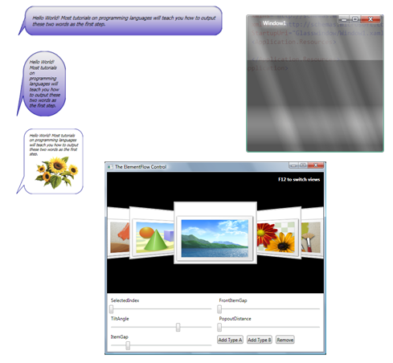
DragDropManager
GlassWindow
PennerDoubleAnimation
ElementFlow
http://www.codeplex.com/fluidkit
ImageButton
BalloonDecorator
ItemSkimmingPanel + SkimmingContextAdorner

Slide 3
Game Plan
Basics about the WPF Visual Tree
Usage
Measure
Arrange
GetVisualChild
VisualChildrenCount
Building ElementFlow from scratch
Quick demo of ElementFlow and other goodies in FluidKit

Slide 4
Basics of the Visual Tree
The WPF abstraction
Every visible object on the application comes from the the Visual Tree
Logical + Visual

Slide 5
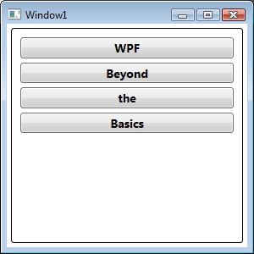
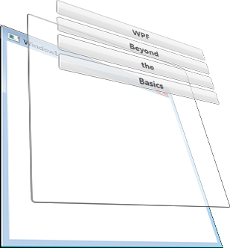
Logical Tree
Window
Border
StackPanel
Button
“WPF”
Button
“Beyond”
Button
“the”
Button
“Basics”

Slide 6
Visual Tree
Border
ContentPresenter
TextBlock
Button
Notes:
Micro visual tree

Slide 7
Logical + Visual
Window
Border
StackPanel
Button
“WPF”
Button
“Beyond”
Button
“the”
Button
“Basics”
Logical
(macro)
ControlTemplate
DataTemplate
Visual
(micro)
Top-level layout
of
Window, UserControl
Border
ContentPresenter
TextBlock
Notes:
“Visual Tree” is often used interchangeably to mean Logical or Visual. The context should generally make this clear.

Slide 8
Layout
Parent
→GetVisualChild()
→VisualChildrenCount
Measure
“What’s your size?”
“My size”
Arrange
“Do layout”
Child

Slide 9
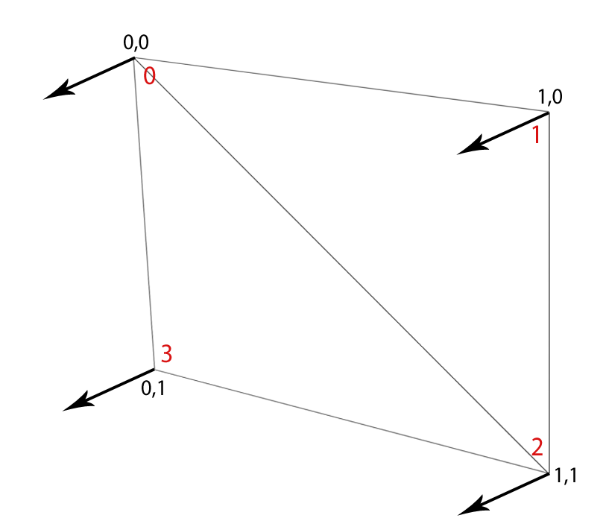
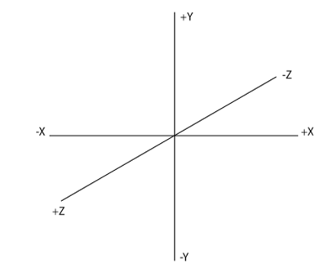
C
O
M
O
E
D

Slide 10
http://groups.google.com/group/wpf-disciples?hl=en

